Slide 1
Synthesis
The format
From http://bit.ly/2lqlKtB

Slide 2
Synthesis
Searches for meaningful and insightful connections between different materials
Identifies common themes and traits
The job of the synthesis essay writer is to explain why the connections and relationships between the sources are important.
** Not a summary or retelling of the plot. It is to create new knowledge and understanding
By revealing points of convergence (similar) or divergence (different), the writer can reveal something hidden

Slide 4
For example…
Consider broad themes. Let’s say the prompt is to “consider how the two protagonists in Text 1 and Text 2 search for identity in a postmodern world”
Your first point of convergence/divergence of the two texts: identity is externally defined for both protagonists in a judgmental world
Your second point of convergence/divergence of the two texts: although both protagonists are isolated by the fabricated notions of identity as defined by society, Protagonist 1 resists external definition by actively controlling his formation of his identity, while Protagonist 2 succumbs to the half-truths defined by her peers.

Slide 5
Key Features of Synthesis
It is organized in a way that readers can immediately see where the information from the sources overlap (therefore, clear assertions are required!!)

Slide 6
Before writing…
Narrow down your topic – often there are many overlaps and ideas – narrow down your topic to a specific perspective or lens to analyze
Summarize briefly common themes or traits in the texts: before you write or even begin to plan, try to clearly define the themes or traits the texts have in common
Develop a thesis statement – what is the main point of your essay? Keep in mind, the thesis you begin with is not set in stone, and may change as your write
Decide how you will use your sources – after considering all the convergences and divergences, you need to decide which information, which parts of your sources you will use.
Organize your writing: decide the order you will use to present your evidence to convince your readers the thesis is true.
Notes:
1. Narrow topic:

Slide 7
Some Things to consider
What is the central message of the story (the theme)
Does the theme overlap in any way with the other text?
Perhaps each text offers two perspectives on the same idea… what could then be the lesson from these two perspectives?
How are the characters treated by other characters, by society?
How does the character change by the end of the story? If they don’t change, what could be the message?
What is the character’s role in the story? Are they successful or do they fail?

Slide 8
Reading techniques
As you read (and reread) have a highlighter or pen to mark points in the sources where you notice a connection or a key idea

Slide 9
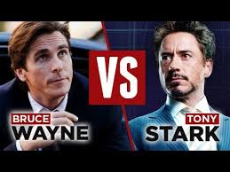
Examples..
Both are affluent and intelligent billionaires who, through tragic circumstances, assume a secondary identity to protect the innocent. While both face their own personal demons, Stark inevitably comes to embrace his heroism publicly, while Wayne instead uses his public persona as the actual mask for his dark knight.

Slide 10
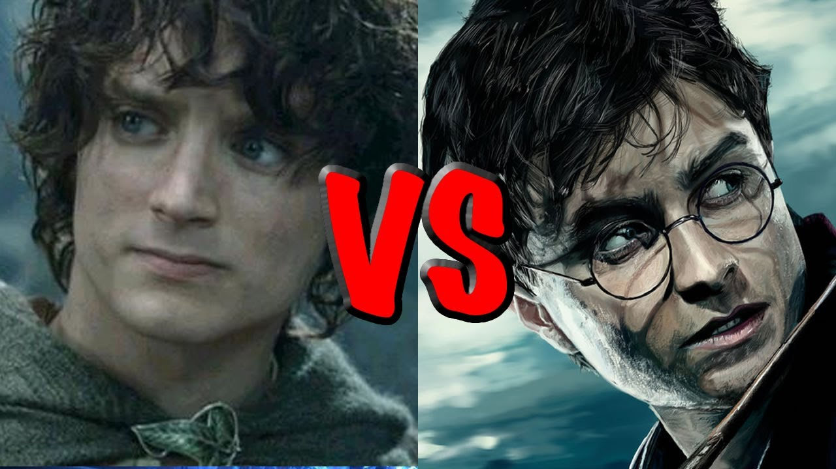
Examples..
Both young men are destined to save their respective people from a villain and his forces bent of genocide and world domination. While both men are supported by band of friends, they each must inevitably overcome their own internal conflicts to successfully save both themselves and their worlds.

Slide 11
Organization
Introduction: - Follows TTAP but expanded to include both sources
Kurt Vonnegut Jr’s short story “Harrison Bergeron” and Rush’s song “The Trees” both deliver a sobering message of the dangers of extreme equality
Body Paragraphs – CLEAR ASSERTIONS – needs to state the point
What is the convergence or divergence of each text? What will it prove?
Includes evidence to support and demonstrate
Explains why this evidence is key – focus on key words and representations
Conclusion: when you have finished your paper, consider the main organizing ideas. What were the primary points of convergence and divergence? How do they connect to the overall topic or theme (big umbrella). Often this theme should connect to the real world or our own lives (stay objective, though!)

